Slide 1


Microsoft Movie Studio Recommendations
Make movies for the world. Maximize value. Minimize risk.

Slide 2

Overview
Microsoft is standing up a new movie studio to compete with other major technology and media companies, but lacks data on what goes into making a successful movie.
EMG Consulting has experience in the field of data analysis. Microsoft has retained our services to perform exploratory analysis and make recommendations.

Slide 3

Our Approach
Using data from The Numbers and IMDB, we created a dataset of over 1,200 movies released between 2012 and 2019 . This dataset was of particular interest because it begins with the year that Netflix released its first Original production, and ends the year before the COVID-19 pandemic upended the movie industry. For each movie, we created visualizations and recommendations based on the following information:
Production budget
Domestic, international, and worldwide gross and profit
Genre(s)
Director

Slide 4
Recommendation #1: Market films internationally to maximize the value of your production dollar.
“There’s still a 1950s view of cinema, that there’s one audience and they all want to see the same thing.”
Michael Winterbottom, Palme d’Or-nominated director

Slide 5
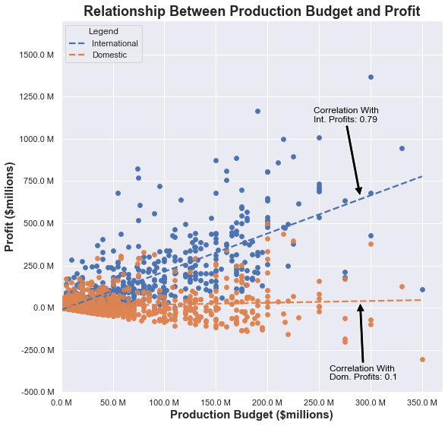
Production dollars earn a better return at the international box office.
The domestic market includes all of North America; the international market covers the rest of the world.
There is a strong positive correlation between production budget and international profit, but nearly no correlation with domestic profit.
On average, at every level of spending on production, studios earned higher profits internationally than they did domestically.

Slide 6
Recommendation #2: Focus on making movies that include a mix of characteristics from the Sci-Fi, Animation, and/or Thriller genres.
“If studios don’t get their money back, we don’t have any movies.”
Ridley Scott, Oscar-nominated director

Slide 7
Delivering Big Profits At A Good Value.
Profit
Profit Ratio
Rank
Profit divided by the average amount spent to make a movie of that genre.
How the Profit and Profit Ratio for a given genre compare to those of other genres.
Average amount earned by a movie of a particular genre.
Notes:
Earning the highest possible overall profit is a key factor for Microsoft to consider in standing up its new enterprise, but the company does not have an infinite budget to do so. The Microsoft movie studio will have to ensure it is investing wisely to maximize the value of each dollar it invests.

Slide 8
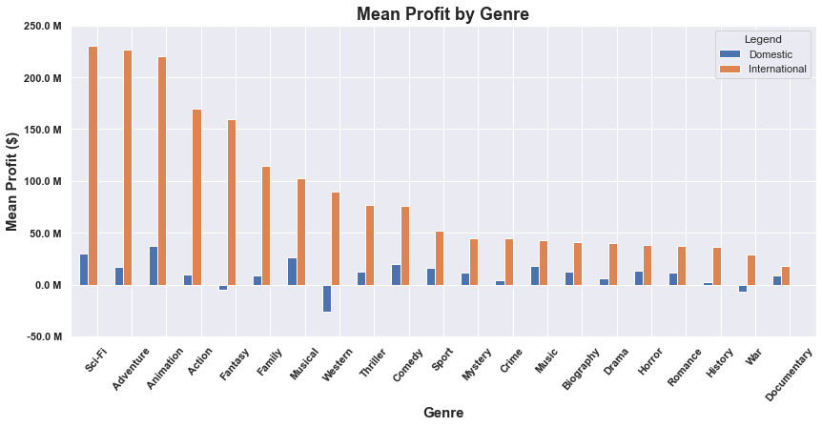
Profit
Notes:
Earning the highest possible overall profit is a key factor for Microsoft to consider in standing up its new enterprise, but the company does not have an infinite budget to do so. The Microsoft movie studio will have to ensure it is investing wisely to maximize the value of each dollar it invests.

Slide 9
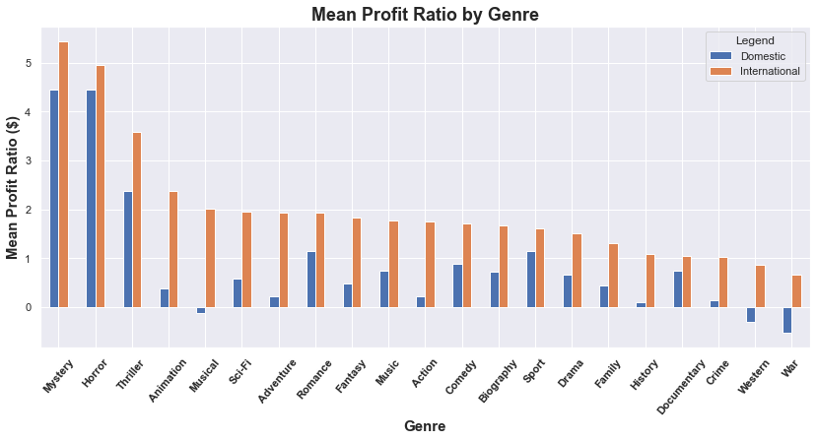
Profit Ratio
Notes:
Earning the highest possible overall profit is a key factor for Microsoft to consider in standing up its new enterprise, but the company does not have an infinite budget to do so. The Microsoft movie studio will have to ensure it is investing wisely to maximize the value of each dollar it invests.

Slide 10
Ranking genres by mean profit and mean profit ratio allows us to identify what types of films deliver the right combination of value and overall return.
We took the average rank for profit and profit ratio in the domestic and international markets, and used this average to create an overall aggregate ranking.
Genre | Overall Ranking
Sci-Fi | 1
Animation | 2
Thriller | 3
Mystery | 4
Horror | 5
Adventure | 6
Comedy | 7
Musical | 8
Sport | 9
Music | 10

Slide 11
Recommendation #3: To mitigate risk, avoid high-budget action films and directors with a track record of losing a lot of money.
“I don’t try to guess what a million people will like. It’s hard enough to know what I like.”
John Huston, Oscar-winning director

Slide 12


Clunkers.
We all hear about it when a movie flops at the box office. Studios plow hundreds of millions of dollars into production on these films, and never see a return. Microsoft needs to mitigate the risk of financing a clunker that will drag down its profits and brand integrity.
01 | Dark Phoenix: $200,237,650 worldwide loss
02 | Men In Black International: $106,900,000 loss

Slide 13
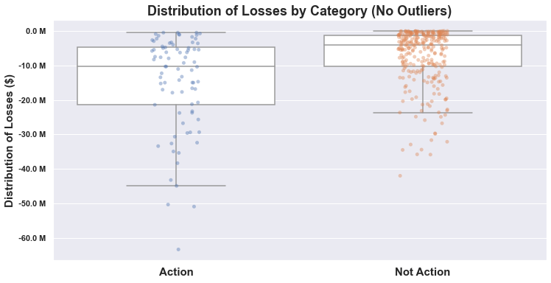
When Action Movies Lose, They Lose Big.
$4,148,310
$10,319,750

Slide 14
Some directors are diamonds in the rough. Some are just rough.
There are a lot of factors that can contribute to a film’s success. Microsoft should factor in whether a director has a track record of major clunkers (films that lost $1 million or more) when selecting people to lead its projects.
Director | Major Clunkers
David Gordon Green | 3
Simon West | 2
Kevin Smith | 2
Justin Chadwick | 2
James Gray | 2
Mira Nair | 2
Jacques Audiard | 2
David Koepp | 2

Slide 15
Thank you.
“I don’t want to tell you how to do your job, but somebody has to.”
- David Fincher, Oscar-nominated director
Contact:
emgerber94@gmail.com GitHub Repository Link

